Slide 1
Centrality of Trees for Capacitated k-Center Hyung-Chan An July 29, 2013 Joint work with Aditya Bhaskara & Ola Svensson Independent work of Chandra Chekuri, Shalmoli Gupta & Vivek Madan

Slide 2
Network Location Problems
Given a metric on nodes (called servers and clients)
Need to connect every client to a server
Need to choose a subset of servers to be used
k-center | minimize maximum connection cost
k-median | minimize average connection cost
facility location | minimize average connection cost opening cost instead of hard budget

Slide 3
Network Location Problems
Given a metric on nodes (called servers and clients)
Need to connect every client to a server
Need to choose a subset of servers to be used
k-center | minimize maximum connection cost
k-median | minimize average connection cost
facility location | minimize average connection cost opening cost instead of hard budget

Slide 4
Network Location Problems
Given a metric on nodes (called servers and clients)
Need to connect every client to a server
Need to choose a subset of servers to be used
k-center | minimize maximum connection cost
k-median | minimize average connection cost
facility location | minimize average connection cost opening cost instead of hard budget

Slide 5
Network Location Problems
Given a metric on nodes (called servers and clients)
Need to connect every client to a server
Need to choose a subset of servers to be used
k-center | minimize maximum connection cost
k-median | minimize average connection cost
facility location | minimize average connection cost opening cost instead of hard budget

Slide 6
Network Location Problems
Uncapacitated problems
Assumes an open server can serve unlimited # clients
 | complexity-theoretic lower bound | approximation ratio
k-center | 2 | 2
k-median | 1.735 | 2.733
facility location | 1.463 | 1.488
[Gonzales 1985] [Hochbaum & Shmoys 1985] [Jain, Mahdian & Saberi 2002]
[Li & Svensson 2013] [Guha & Khuller 1999] [Li 2011]

Slide 7
Network Location Problems
Capacitated problems
 | complexity-theoretic lower bound | approximation ratio
k-center | 3 | O(1)
k-median | 1.735
facility location | 1.463 | 5
[Cygan, Hajiaghayi & Khuller 2012] [Jain, Mahdian & Saberi 2002]
[Guha & Khuller 1999] [Bansal, Garg & Gupta 2012]

Slide 8
Bridging this discrepancy
How does the capacity impact the problem structure?
How can we use mathematical programming relaxations?

Slide 9
The problem
Capacitated k-center
Very good understanding of the uncapacitated case
Reduced to a combinatorial problem on unweighted graphs
Problem
Given k and a metric cost c on V with vertex capacities L : V→Z_{≥0}, choose k centers to open, along with an assignment of every vertex to an open center that:
minimizes longest distance between a vertex & its server
each open center v is assigned at most L(v) clients

Slide 10
Main result
Simple algorithm with clean analysis
Improvement in approximation ratio & integrality gap (9-approximation)
Tree instances

Slide 11
Reduction to unweighted graphs
Guess the optimal solution value τ
Consider a graph G representing admissible assignments: G has an edge (u, v) iff c(u, v) ≤ τ
Will either
certify that G has no feasible assignment
find an assignment that uses paths of length ≤ ρ
⇒ ρ-approximation algorithm

Slide 12
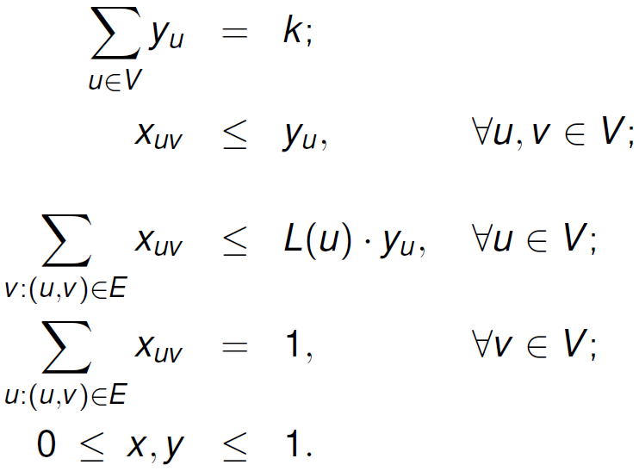
Standard LP relaxation
Feasibility LP
Assignment variables
Opening variables

Slide 13
Standard LP relaxation
Unbounded integrality gap
k = 3, uniform capacity of 2

Slide 14
Standard LP relaxation
Unbounded integrality gap
k = 3, uniform capacity of 2
Lemma (Cygan et al.)
It suffices to solve this combinatorial problem only for connected graphs.

Slide 15
Outline
Basic definitions
distance-r transfer
tree instance
Solving a tree instance
Applications
Future directions

Slide 16
What does it mean to round an LP soln?
(x*, y*): LP solution
y* fractionally opens vertices
If y* integral, done
We will “transfer” openings between vertices to make them integral
No new opening created
Need to ensure that a
small-distance assignment
exists

Slide 17
What does it mean to round an LP soln?
We will “transfer” openings between vertices to make them integral
Need to ensure that a small-distance assignment exists
transfers in small vicinity
locally available capacity does not decrease
L=1
L=1000

Slide 18
Distance-r transfer
Fractionally open vertex u has “fractional capacity” L(u)y_{u}
Our rounding procedure “redistributes” these frac. cap.
A distance-r transfer give a redistribution where locally available capacity does not decrease
Definition
y' is a distance-r transfer of y if
for all

Slide 19
Distance-r transfer
Dist-2 transfer
All cap. 4
Definition
y' is a distance-r transfer of y if
for all

Slide 20
Distance-r transfer
Lemma
If we can find a distance-8 transfer of an LP solution, we obtain a 9-approximation solution
Definition
y' is a distance-r transfer of y if
for all

Slide 21
Tree instance
Definition
A tree instance is a rooted tree of fractionally open vertices where every internal node v is fully open: i.e. y_{v} = 1
Focusing on servers only
Why is this interesting?

Slide 22
Reduction to a tree instance
Lemma (Khuller & Sussmann, informal)
A connected graph can be partitioned into small-diameter clusters
u
u
u
v
w
x

Slide 23
Reduction to a tree instance
Lemma
If we can find an integral distance-r transfer of a tree instance, we obtain a (3r+3)-approximation algorithm for capacitated k-center
Want: distance-2 transfer of a tree instance

Slide 24
Solving a tree instance
Example (uniform capacity)

Slide 25
Solving a tree instance
Example (uniform capacity)

Slide 26
Solving a tree instance
Example (the two nodes have capacity 10, others 1000)

Slide 27
Solving a tree instance
Example (the two nodes have capacity 1000, others 10)

Slide 28
Solving a tree instance
Example (the two nodes have capacity 1000, others 10)

Slide 29
Solving a tree instance
Example (the two nodes have capacity 1000, others 10)

Slide 30
Solving a tree instance
Example (the two nodes have capacity 1000, others 10)

Slide 31
Solving a tree instance
Closing a fully open center
Useful strategy; but its viability depends on the choice of open centers in the neighborhood
Our algorithm departs from previous approaches by using a simple local strategy for every internal node

Slide 32
Solving a tree instance
Our algorithm
Locally round a height-2 subtree to obtain a smaller instance
1
Would want to open Y+1 centers in the subtree
Instead will open either ⌊Y ⌋+1 or ⌈Y ⌉+1 centers
Choose ⌊Y ⌋+1 centers and commit now to open them
Choose one additional candidate for which the decision is postponed
1
.9
.4
1
.7
Y: total opening of children
(2.1)

Slide 33
Solving a tree instance
Our algorithm
⌊Y ⌋+1 centers to commit
1
1
.9
.4
1
.7
Y = 2.1

Slide 34
Solving a tree instance
Our algorithm
⌊Y ⌋+1 centers to commit
Choose ⌊Y ⌋ children of highest capacities
1
1
.9
.4
1
.7
Y = 2.1

Slide 35
Solving a tree instance
Our algorithm
⌊Y ⌋+1 centers to commit
Choose ⌊Y ⌋ children of highest capacities
Between the next highest and the subtree root, choose the higher capacity
1
1
.9
.4
1
.7
Y = 2.1

Slide 36
Solving a tree instance
Our algorithm
Additional candidate
Would want to fractionally open the other node by Y-⌊Y ⌋
This node becomes the candidate
1
1
.9
.4
1
.7
Y = 2.1

Slide 37
Solving a tree instance
Our algorithm
Contract the subtree, replaced with a new node with
Capacity equal to the candidate
Opening Y - ⌊Y ⌋
Recursively solve the new instance; if the new node gets opened, the candidate gets opened
1
1
1
.9
.1
.9
.4
1
.7
Y = 2.1

Slide 38
Solving a tree instance
Our algorithm
Choose highest capacity children, as many as allowed
Choose one more: root or next highest child
The other becomes the candidate
Contract the subtree into a new node
Recursively solve the new instance; if the new node gets opened, the candidate gets opened

Slide 39
Solving a tree instance
Natural algorithm
chooses highest-capacity nodes in a small vicinity and opens opportunity to the next highest
Correctness
Candidate may be coming from deep inside the subtree
Subtree root either gets opened or becomes the candidate
Optimal

Slide 40
Main result & applications
Lemma We can find an integral distance-2 transfer of a tree instance
Lemma If we can find an integral distance-r transfer of a tree instance, we obtain a (3r+3)-approximation algorithm for capacitated k-center
Theorem ∃ 9-approximation alg for capacitated k-center
Theorem ∃ 11-approximation alg for capacitated k-supplier
Theorem ∃ 9-approximation alg for budgeted-center w/ uniform cap.

Slide 41
Future directions
Can we do better?
Integrality gap lower bound is 7
Our algorithm runs in three phases:
Preprocessing (finding connected components)
Reduction to a tree instance
Solving the tree instance
{0, L}-instances
Inapproximability and integrality gap lower bound both comes from this special case
Better preprocessing gives a 6-approximation algorithm: improved integrality gap!

Slide 42
Future directions
Is there a better preprocessing for the general case?
Is there a notion that incorporates these preprocessings?
Would such a notion be applicable to other network location problems using similar relaxations?

Slide 43
Thank you.

