Slide 1
Dynamic Facility Location via Exponential Clocks
Hyung-Chan An
July 29, 2013
Joint work with Ashkan Norouzi-Fard and Ola Svensson

Slide 2
Classical facility location problem
Given a metric cost c on
  D: set of clients
  F: set of facilities
6
2
1
5

Slide 3
Classical facility location problem
Given a metric cost c on
  D: set of clients
  F: set of facilities
    o_{i}: opening cost of i∈F
5
100
1

Slide 4
Classical facility location problem
Given a metric cost c on
  D: set of clients
  F: set of facilities
    o_{i}: opening cost of i∈F
Want:
  Choose S⊆F to open
  Assign every client to an open facility f : D→S
5
100
1

Slide 5
Classical facility location problem
Given a metric cost c on
  D: set of clients
  F: set of facilities
    o_{i}: opening cost of i∈F
Want:
  Choose S⊆F to open
  Assign every client to an open facility f : D→S
  Minimize Σ_{i∈S} o_{i} + Σ_{j∈D} c_{j,f(j)} = (1 + 5) + (2 + 2 + 2 + 5 + 2 + 3)
2
2
5
2
100
5
2
3
1

Slide 6
Dynamic facility location problem [Eisenstat et al. 2014]
Dynamics of evolving social / infrastructure networks
Given a metric cost c¹, … ,c^{T} on
  D: set of clients
  F: set of facilities
    o_{i}: opening cost of i∈F
For each timestep t:
  Choose S^{t}⊆F to open
  Assign every client to an open facility f ^{t} : D→S^{t}
“Stable” solution
  Switching cost g every time a client changes its assignment

Slide 7
Dynamic facility location problem
Example [Eisenstat et al. 2014]
  Task: given geographical locations of people, identify groups

Slide 8
Dynamic facility location problem
Example [Eisenstat et al. 2014]
  Task: given geographical locations of people, identify groups
1

Slide 9
Dynamic facility location problem
Example [Eisenstat et al. 2014]
  Task: given geographical locations of people, identify groups
  Set F as D, with uniform opening cost of 1

Slide 10
Dynamic facility location problem
Example [Eisenstat et al. 2014]
  Task: given geographical locations of people, identify groups
  Set F as D, with uniform opening cost of 1
cost 2+ϵ

Slide 11
Dynamic facility location problem
Example [Eisenstat et al. 2014]
  Task: given geographical locations of people, identify groups
c¹

Slide 12
Dynamic facility location problem
Example [Eisenstat et al. 2014]
  Task: given geographical locations of people, identify groups
c¹
c²

Slide 13
Dynamic facility location problem
Example [Eisenstat et al. 2014]
  Task: given geographical locations of people, identify groups
c¹
c²
c³

Slide 14
Dynamic facility location problem
Example [Eisenstat et al. 2014]
  Task: given geographical locations of people, identify groups
  Switching cost: g = 0
c¹
c²
c³
cost 5+ϵ (+8g)

Slide 15
Dynamic facility location problem
Example [Eisenstat et al. 2014]
  Task: given geographical locations of people, identify groups
  Switching cost: g = 100
c¹
c²
c³
cost 6+ϵ

Slide 16
Dynamic facility location problem
O(log(nT))-approximation algorithm [Eisenstat et al. 2014]
  Does not use triangle inequality
Can we use triangle inequality to get better approximation?

Slide 17
Main result
Theorem
There exists an LP-rounding O(1)-approximation algorithm for dynamic facility location

Slide 18
Introduction
Algorithm

Slide 19
Standard LP (for classical)
Variables
  ∀i∈F y_{i}=1 if open, 0 if not
  ∀i∈F, j∈D x_{ij}=1 if j is assigned to i, 0 if not
Minimize Σ_{i∈F} o_{i}y_{i} + Σ _{i∈F, j∈D} c_{ij}x_{ij}
subject to x_{ij} ≤ y_{i} ∀i∈F, j∈D
Σ_{i∈F} x_{ij} ≤ 1 ∀j∈D
x, y ≥ 0

Slide 20
Standard LP (for dynamic)
Variables for timestep t
  ∀i∈F y_{i}=1 if open, 0 if not
  ∀i∈F, j∈D x_{ij}=1 if j is assigned to i, 0 if not
^{t}
^{t}
Minimize Σ_{t} (Σ_{i∈F} o_{i}y_{i} + Σ _{i∈F, j∈D} c_{ij}x_{ij}) + g/2·Σ_{t} ||x^{t+1}-x^{t}||₁
subject to x_{ij} ≤ y_{i} ∀i∈F, j∈D, t∈[T]
Σ_{i∈F} x_{ij} ≤ 1 ∀j∈D, t∈[T]
x, y ≥ 0
^{t}
^{t}
^{t}
^{t}
^{t}

Slide 21
Standard LP (for classical)
Our algorithm rounds each timestep separately
  Can focus on the classical LP
Minimize Σ_{i∈F} o_{i}y_{i} + Σ _{i∈F, j∈D} c_{ij}x_{ij}
subject to x_{ij} ≤ y_{i} ∀i∈F, j∈D
Σ_{i∈F} x_{ij} ≤ 1 ∀j∈D
x, y ≥ 0

Slide 22

Representing an LP solution
Simplifying assumption
  Rational solution with common denominator M
  x_{ij} ∈ {0, $\frac{1}{M}$}, y_{i} = $\frac{1}{M}$

Slide 23
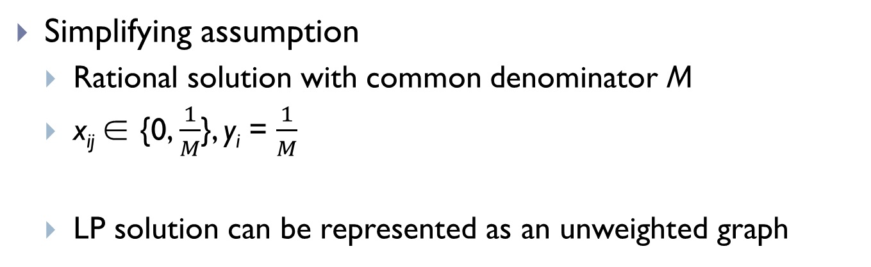
Representing an LP solution
Simplifying assumption
  Rational solution with common denominator M
  x_{ij} ∈ {0, $\frac{1}{M}$}, y_{i} = $\frac{1}{M}$
  LP solution can be represented as an unweighted graph
1/4
3/4
2/4
0/4
3/4
2/4
1/4
2/4

Slide 24
Previous LP-rounding algorithms
[Shmoys et al. 1997]
[Chudak & Shmoys 2003]
[Byrka & Aardal 2010]
If
  each facility is opened w. p. 1/M, and
  each client j is connected via an edge (j, i) w. p. 1/M,
  done!

Slide 25
Previous LP-rounding algorithms
[Shmoys et al. 1997]
[Chudak & Shmoys 2003]
[Byrka & Aardal 2010]
If
  each facility is opened w. p. 1/M, and
  each client j is connected via an edge (j, i) w. p. 1/M,
  done!
Clusters of M facilities, centered at clients

Slide 26
Previous LP-rounding algorithms
[Shmoys et al. 1997]
[Chudak & Shmoys 2003]
[Byrka & Aardal 2010]
If
  each facility is opened w. p. 1/M, and
  each client j is connected via an edge (j, i) w. p. 1/M,
  done!
Clusters of M facilities, centered at clients
  Open exactly 1 facility in each cluster

Slide 27
Previous LP-rounding algorithms
[Shmoys et al. 1997]
[Chudak & Shmoys 2003]
[Byrka & Aardal 2010]
If
  each facility is opened w. p. 1/M, and
  each client j is connected via an edge (j, i) w. p. 1/M,
  done!
Clusters of M facilities, centered at clients
  Open exactly 1 facility in each cluster

Slide 28
Previous LP-rounding algorithms
[Shmoys et al. 1997]
[Chudak & Shmoys 2003]
[Byrka & Aardal 2010]
If
  each facility is opened w. p. 1/M, and
  each client j is connected via an edge (j, i) w. p. 1/M,
  done!
Clusters of M facilities, centered at clients
  Open exactly 1 facility in each cluster
  “Fallback path” of length 3 guaranteed

Slide 29
Question
Can we use longer paths?
  Yes. Our algorithm uses arbitrarily long paths.
Can we do without clustering?
  Clustering is sensitive to small change in x
  Yes. Our algorithm does not use clustering.

Slide 30
Our algorithm

Slide 31
Our algorithm
Sample i.i.d. “clocks” on each node from Exp(1)
.83
.50
.75
.70
.78
.81
.73
.90
.82
.84
.72
.79
.91
.85
.88
.71

Slide 32
Our algorithm
Sample i.i.d. “clocks” on each node from Exp(1)
Each node chooses a node with the smallest clock in its neighborhood⇒
.83
.50
.75
.70
.78
.81
.73
.90
.82
.84
.72
.79
.91
.85
.88
.71

Slide 33
Our algorithm
Sample i.i.d. “clocks” on each node from Exp(1)
Each node chooses a node with the smallest clock ⇒ connection graph G_{C}

Slide 34
Our algorithm
Sample i.i.d. “clocks” on each node from Exp(1)
Each node chooses a node with the smallest clock ⇒ connection graph G_{C}
Open every facility on cycles

Slide 35
Our algorithm
Sample i.i.d. “clocks” on each node from Exp(1)
Each node chooses a node with the smallest clock ⇒ connection graph G_{C}
Open every facility on cycles
Connect each client by following the uniquely defined connection path

Slide 36
Our algorithm
Sample i.i.d. “clocks” on each node from Exp(1)
Each node chooses a node with the smallest clock ⇒ connection graph G_{C}
Open every facility on cycles
Connect each client by following the uniquely defined connection path
Suffices to bound the length of connection paths

Slide 37
Analysis
Easy to show that every facility is opened w. p. 1/M
Focus on connection cost

Slide 38
Analysis

Slide 39
Analysis
When will j₁’s connection path starts with these six arcs?
i₂
i₁
j₂
j₃
j₁
i₃
j₄

Slide 40
Analysis
When will j₁’s connection path starts with these six arcs?
  i₁ has the smallest clock in j₁’s neighbor
  j₂ has the smallest clock in i₁’s neighbor
  i₂ has the smallest clock in j₂’s neighbor
i₂
i₁
j₂
j₃
j₁
i₃
:
j₄

Slide 41
Analysis
When will j₁’s connection path starts with these six arcs?
  i₁ has the smallest clock in j₁’s neighbor
  j₂ has the smallest clock in i₁’s neighbor
  i₂ has the smallest clock in j₂’s neighbor
i₂
i₁
j₂
j₃
j₁
i₃
:
j₄

Slide 42
Analysis
When will j₁’s connection path starts with these six arcs?
  i₁ has the smallest clock in j₁’s neighbor
  j₂ has the smallest clock in i₁’s neighbor
  i₂ has the smallest clock in j₂’s neighbor
i₂
i₁
j₂
j₃
j₁
i₃
:
j₄

Slide 43
Analysis
When will j₁’s connection path starts with these six arcs?
  i₁ has the smallest clock in j₁’s neighbor
  j₂ has the smallest clock in i₁’s neighbor
  i₂ has the smallest clock in {j₁, j₂}’s neighbor
i₂
i₁
j₂
j₃
j₁
i₃
:
j₄

Slide 44
Analysis
When will j₁’s connection path starts with these six arcs?
  i₁ has the smallest clock in j₁’s neighbor
  j₂ has the smallest clock in i₁’s neighbor
  i₂ has the smallest clock in {j₁, j₂}’s neighbor
  j₃ has the smallest clock in {i₁, i₂}’s neighbor
  i₃ has the smallest clock in {j₁, j₂, j₃}’s neighbor
  j₄ has the smallest clock in {i₁, i₂, i₃}’s neighbor
i₂
i₁
j₂
j₃
j₁
i₃
j₄

Slide 45
Analysis
Probability rapidly decreases as we consider longer paths!
For each e,
  Consider all possible paths in the connection graph containing e, sum their probabilities

Slide 46
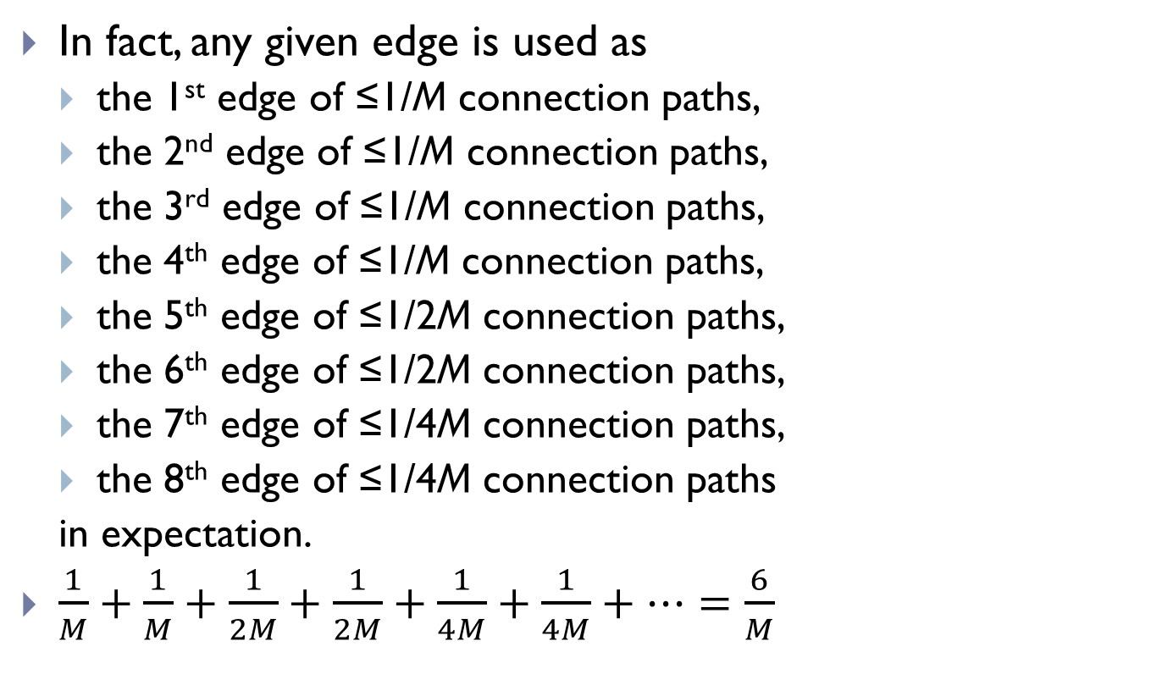
Analysis
In fact, any given edge is used as
  the 1st edge of ≤1/M connection paths,
  the 2nd edge of ≤1/M connection paths,
  the 3rd edge of ≤1/M connection paths,
  the 4th edge of ≤1/M connection paths,
  the 5th edge of ≤1/2M connection paths,
  the 6th edge of ≤1/2M connection paths,
  the 7th edge of ≤1/4M connection paths,
  the 8th edge of ≤1/4M connection paths
  in expectation.
$\frac{1}{M}+\frac{1}{M}+\frac{1}{2M}+\frac{1}{2M}+\frac{1}{4M}+\frac{1}{4M}+…=\frac{6}{M}$

Slide 47
Analysis
1-approximation for opening cost
6-approximation for connection cost
Lagrangian-preserving 6-approximation for classical facility location

Slide 48
Analysis
Switching cost
  Two solutions differ only in j’s connection variables
j
j

Slide 49
Analysis
Switching cost
  Two solutions differ only in j’s connection variables
  Can this affect the connection path of client j’?
  In expectation, affects 7 connection paths
j
j
j’
j’

Slide 50
Analysis
1-approximation for opening cost
6-approximation for connection cost
14-approximation for switching cost
Theorem
There exists a 14-approximation algorithm for dynamic facility location

Slide 51
Main results
A new LP-rounding algorithm
  Using long connection paths
  No clustering
  First constant approximation for dynamic facility location
  Lagrangian-preserving 6-approximation

Slide 52
Open questions
Application to other dynamic settings
Better analysis for
  dynamic facility location
  classic facility location

Slide 53
Thank you.

